Slide 1
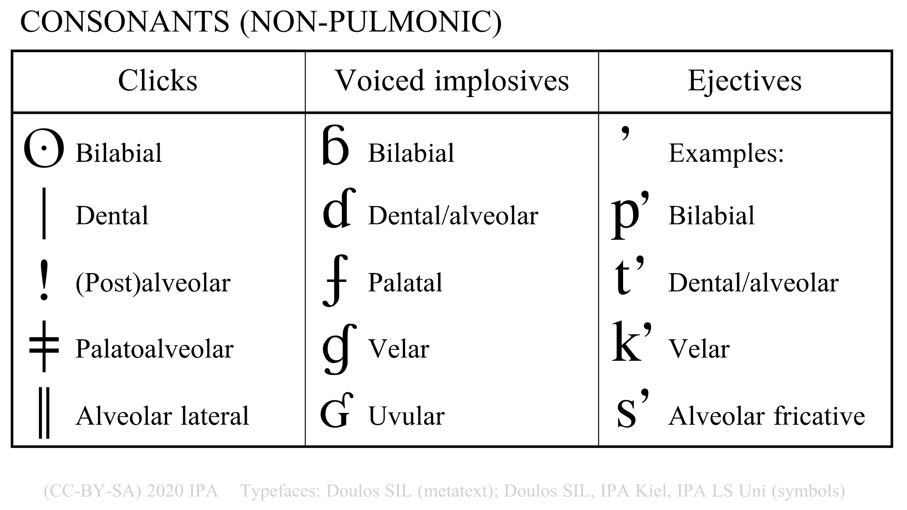

Identification and Transcription of non-pulmonic consonants
TASK
Listen to each nonsense words and write a narrow phonetic transcription.
Pay attention to pulmonic and non-pulmonic sounds.
There is no need to use diacritics.
Click on the question marks to see suggested answers.
A
B
C
D
E
F
?
?
?
?
?
?
created by Antoin Rodgers under Creative Commons Attribution-ShareAlike 4.0 License - rodgeran@tcd.ie - @phonetic_antoin
Notes:
“Five groups of moveable structures”
Mention tongue root attached to the hyoid bone and epiglottis
Also mention (?) that the tongue can be futher sub-divided (see Ladefoged and Johnson)
“Nine regions considered as targets of the active articulators”
Remember to point out glottal NOT a passive articulator, but in image as a reference point

